Slide 1
Word Embeddings

Slide 2
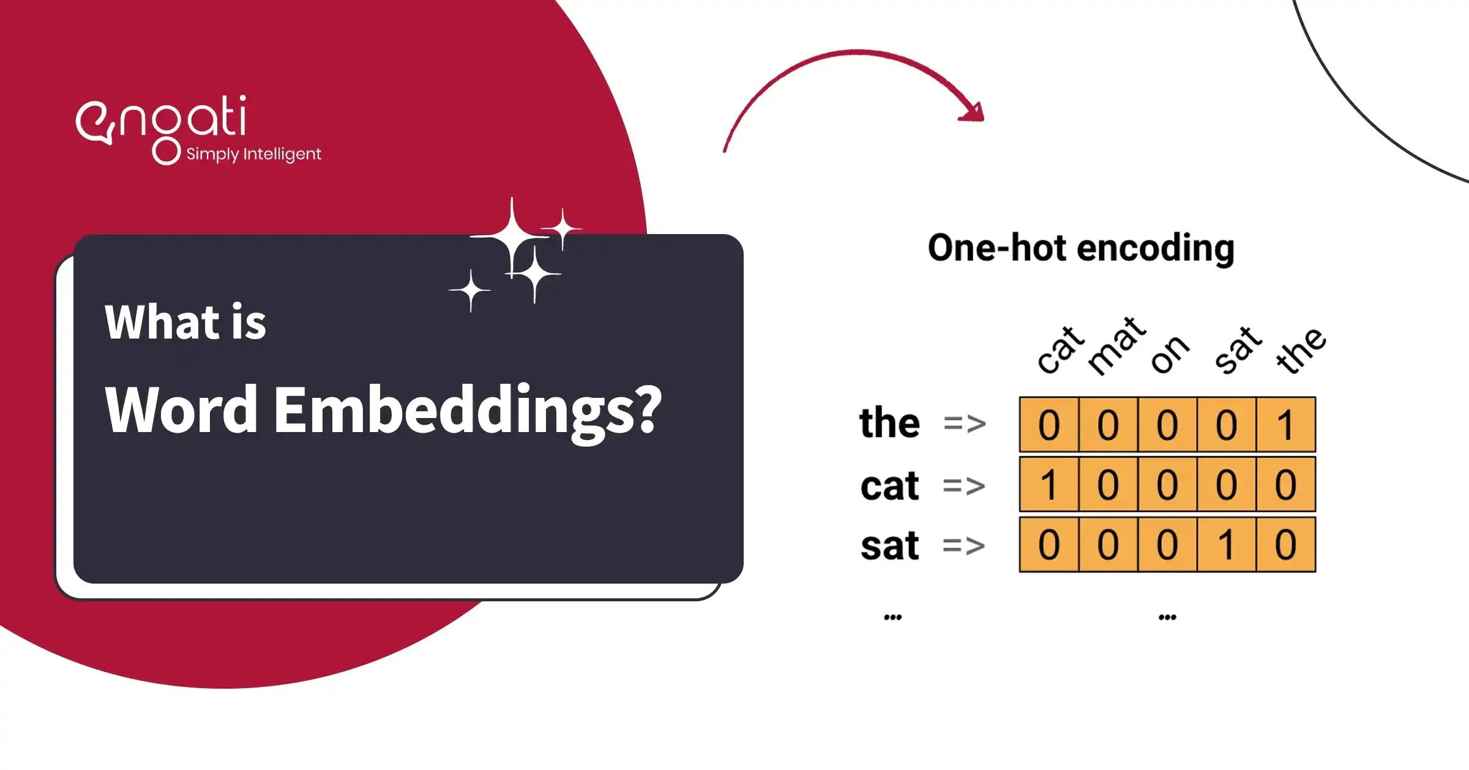
Introduction
Word embeddings are a way to represent words as vectors in a continuous vector space.
They capture semantic relationships between words and are widely used in natural language processing tasks.
Word embeddings have revolutionized how machines understand and process human language.
1
Notes:
Image source: https://www.engati.com/glossary/word-embeddings

Slide 3
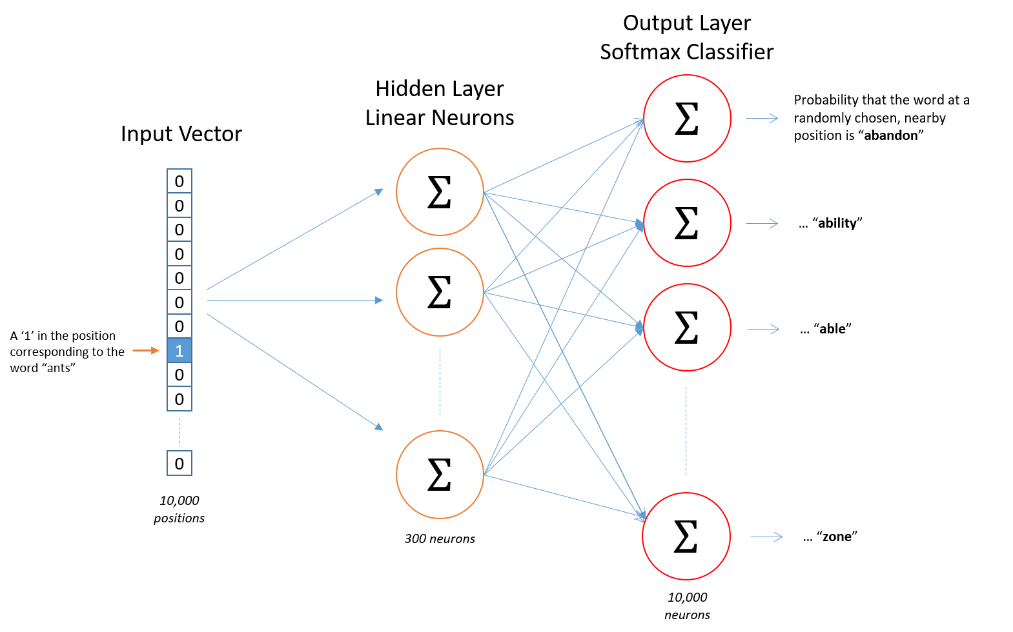
Word2Vec (Word to Vector)
Word2Vec is a popular word embedding technique developed by Google.
It uses a shallow neural network to learn word embeddings from large text corpora.
Word2Vec has two models:
Continuous Bag of Words (CBOW)
Skip-gram.
2
Notes:
Image source: https://israelg99.github.io/2017-03-23-Word2Vec-Explained/

Slide 4
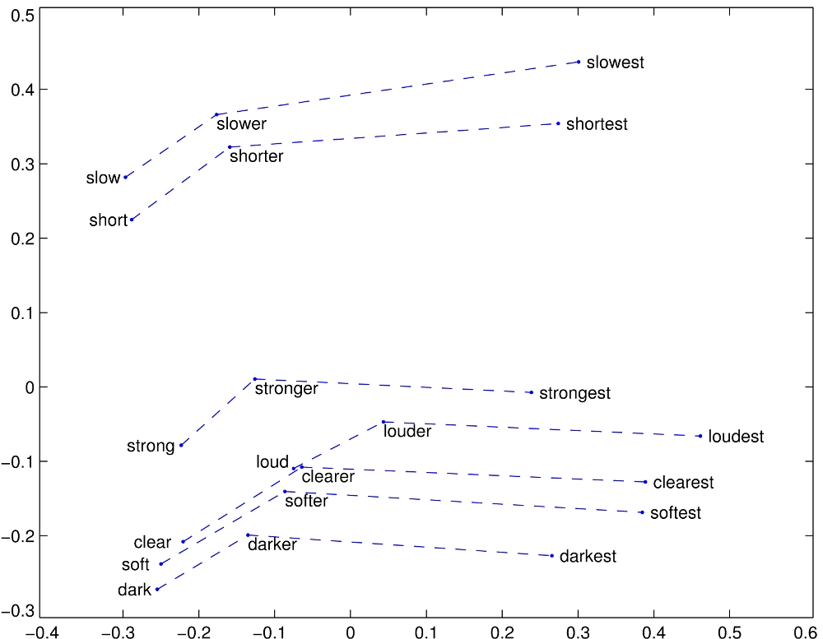
GloVe (Global Vectors for Word Representation)
GloVe is another widely used word embedding technique developed by Stanford researchers.
It leverages global word-word co-occurrence statistics to learn word embeddings.
GloVe embeddings capture both syntactic and semantic relationships between words.
3
Notes:
Image source: http://www-nlp.stanford.edu/projects/glove/

Slide 5
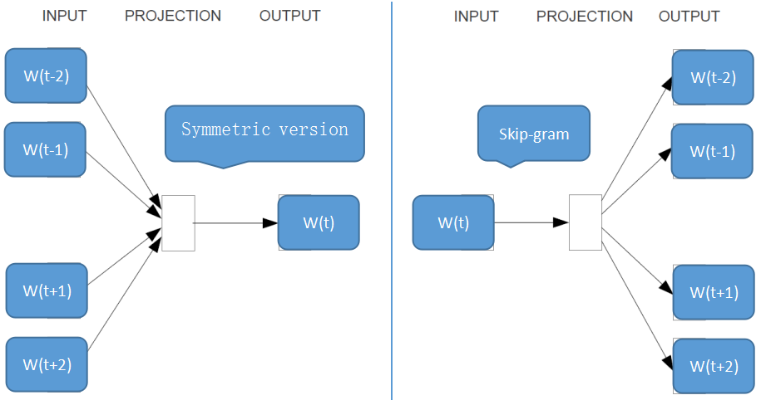
FastText
FastText is an extension of Word2Vec developed by Facebook AI Research.
It introduces subword information by representing words as bags of character n-grams.
FastText is particularly useful for handling out-of-vocabulary words and capturing morphological information.
4
Notes:
Image source: https://zhuanlan.zhihu.com/p/32096348

Slide 6
t-SNE (t-Distributed Stochastic Neighbor Embedding)
t-SNE is a dimensionality reduction technique commonly used for visualizing high-dimensional data.
It is often used to visualize word embeddings in a lower-dimensional space.
t-SNE preserves local structure in the data, making it ideal for clustering and visualization.
5
Notes:
Image source: https://www.researchgate.net/figure/t-distributed-stochastic-neighbor-embedding-t-SNE-results-in-two-dimension-2D-with_fig3_346993295

Slide 7
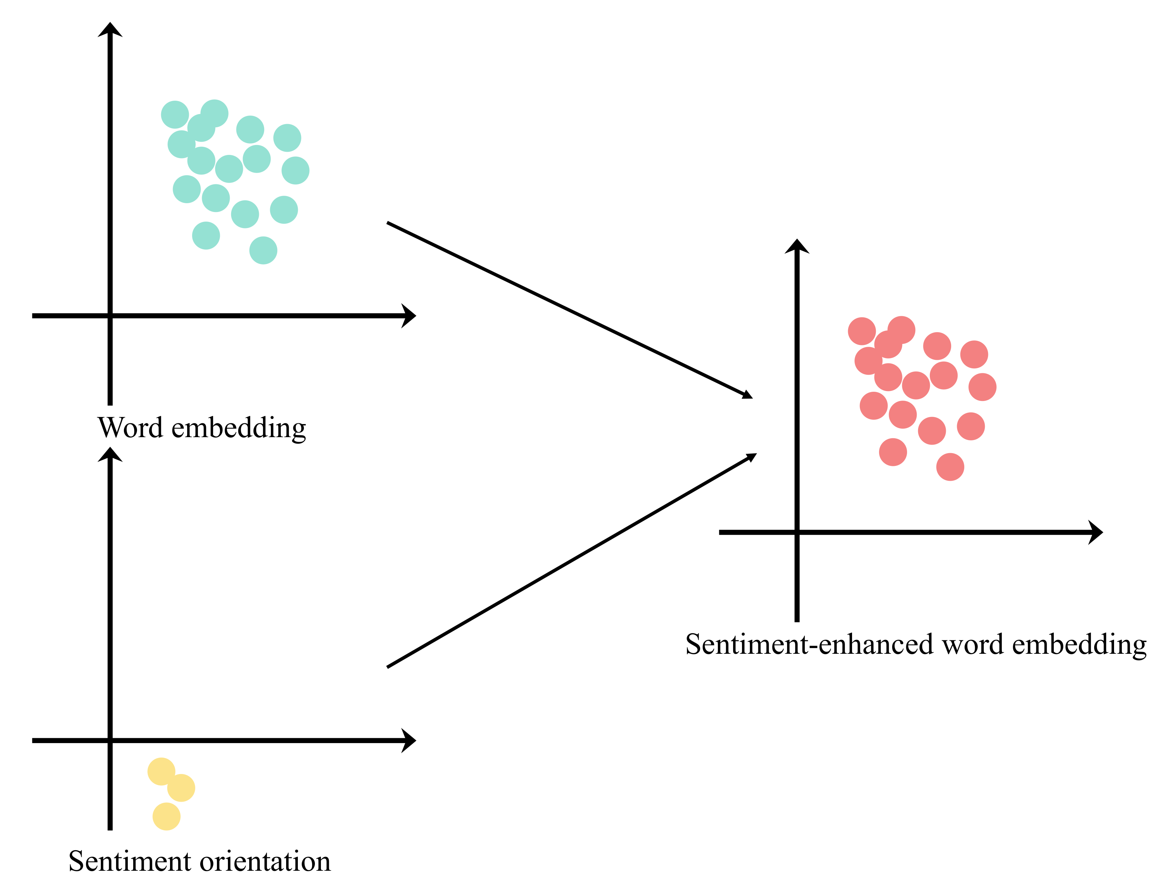
Applications of Word Embeddings
Word embeddings are used in sentiment analysis to understand the emotional tone of text.
They are employed in machine translation to improve language understanding.
Word embeddings power recommendation systems by capturing user preferences and content similarities.
6
Notes:
Image source: https://www.mdpi.com/2076-3417/12/20/10236

Slide 8
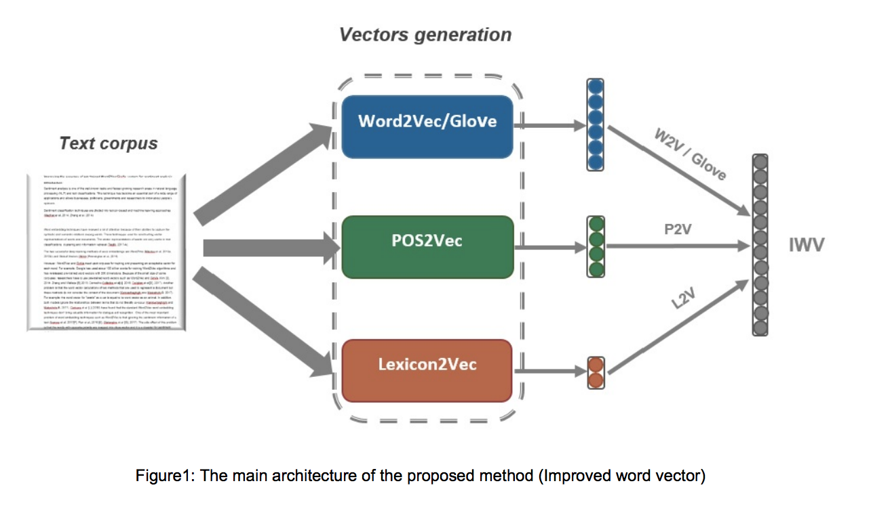
Conclusion
Word embeddings such as Word2Vec, GloVe, FastText, and t-SNE have revolutionized natural language processing tasks.
They enable machines to understand, process, and generate human language more effectively.
The applications of word embeddings continue to grow across various industries, driving advancements in AI and machine learning.
10
Notes:
Image source: https://awesomeopensource.com/project/PrashantRanjan09/Improved-Word-Embeddings

